Slide 1

Spambase dataset
Objective : predicting if a mail is a spam
Author : Matthieu COLIN
Teachers : R. JOUIN, B. BEJNBAUM
2020-2021

Slide 2
Attributes informations
48 attributes of type word_freq_WORD = percentage of words in the e-mail that match WORD [0,100]
6 attributes of type char_freq_CHAR = percentage of characters in the e-mail that match CHAR [0,100]
1 attribute of type capital_run_length_average = average length of uninterrupted sequences of capital letters [1,...]
1 continuous integer attribute of type capital_run_length_longest = length of longest uninterrupted sequence of capital letters [1,...]
1 continuous integer attribute of type capital_run_length_total = sum of length of uninterrupted sequences of capital letters = total number of capital letters in the e-mail [1,...]
1 nominal class attribute of type spam = denotes whether the e-mail was considered spam (1) or not (0),
M.COLIN
2020-2021

Slide 3
Attributes informations
We have no informations on how frequencies is calculated for words and char. Without knowing that, we will not try to make any visual analysis or conclusion with those attributes.
That means we’re keeping the capital run length average, the capital run length longest, total capital and the spam label.
Capitals attributes are enough to confirm what we could think: spams are using more capitals in general. But still a lot of spams got low capitals values so we will need more elements to answer our question.
M.COLIN
2020-2021

Slide 4
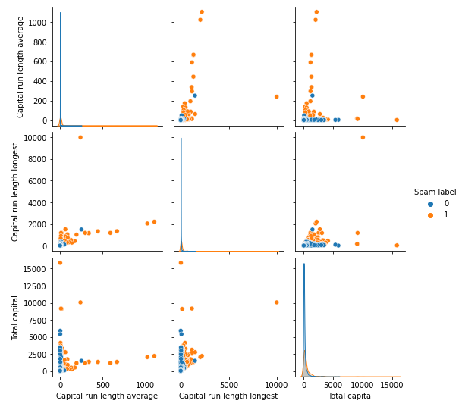
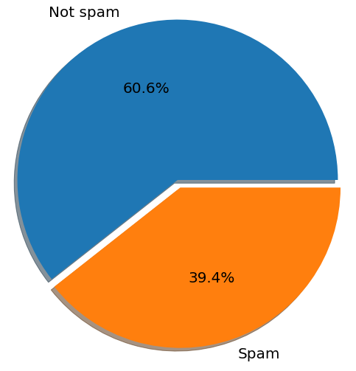
Visualisation
Even if we have only 39,4% of Spam, there are the ones standing out more on a pairplot with capitals attributes:
M.COLIN
2020-2021

Slide 5
Models
We wanted to try a simple model first, and then moving to more sophisticated ones.
Each time we will try with basics parameters and apply after differents values and use a RandomizedSearchCV to find the best hyperparameters of our model
Analyzing results with classification reports
OBJECTIVE: Minimize false positives, since the priority is to have less mails as possible predicted as spam when they had real information.
M.COLIN
2020-2021

Slide 6
Why Logistic Regression ?
Our dependent varaible is binary (spam or not spam)
Fast and effective classification model
Simple but can be very precise if our values have little multicollinearity which can be the case with all our words frequencies attributes

Slide 7
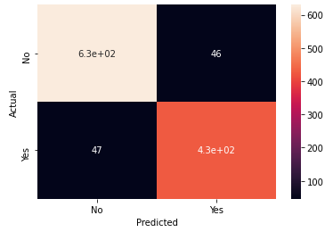
Logistic Regression results
Surprisingly high: 91% with any parameter changed
92% precision with our best parameters, with only 47 false positives.

Slide 8
Why Random Forest?
Tree-based methods are simple and useful for interpretation
See how our results evovle with the number of trees
Can be very powerful with datasets with non-linear trend

Slide 9
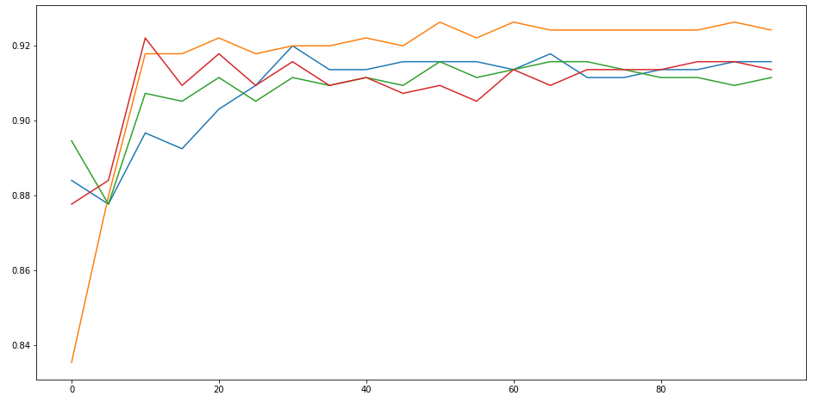
Random Forest Visualisation
To avoid overfitting, we want to know what is the perfect number of trees, for that we will fit 5 Random Forests to see how their precision change with the number of trees.
We can confirm that it not usefull to do more than 30 trees.
Precision
Number of trees

Slide 10
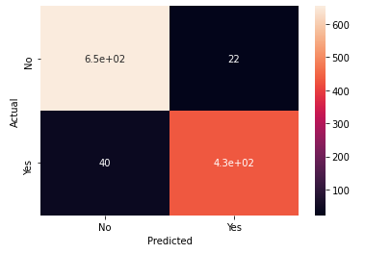
Random Forest results
Better but less effective result compared to logistic regression
95% Precision with only 40 false positives on our best model

